Slide 1
Design and Analysis of Algorithms
Algorithms-II : CS345A
Website: hello.iitk.ac.in
Lecture 5
Divide and Conquer Paradigm - V

Slide 2
Recap from Lecture 1
An algorithm for multiplying two polynomials

Slide 3
a Divide and Conquer algorithm for
Polynomial Evaluation Problem

Slide 4














Divide Step
Attempt 2
$$A\left(x\right)= ? + ?$$
$A_{even}(x)$= $a_{0}+a_{2}x+ …+a_{n−2}x^{\frac{n}{2}−1}$
$A_{odd}(x)$ = $a_{1}+a_{3}x+ …+a_{n−1}x^{\frac{n}{2}−1}$,
Evaluating $A$ at $S$ =
$$A\left(x\right)=a_{0}+a_{1}x+a_{2}x^{2}+ …a_{n−1}x^{n−1}$$
$$S$$
$$\left(a_{0}+a_{2}x^{2}+…+a_{n−2}x^{n−2}\right)$$
$$(a_{1}x+a_{3}x^{3}+…+a_{n−1}x^{n−1}\text{)}$$
All odd terms of $A\left(x\right)$
All even terms of $A\left(x\right)$
$x⋅(a_{1}+a_{3}x^{2}+…+a_{n−1}x^{n−2}$)
$A\left(x\right)=$ $A_{even}$($x^{2}$) + $x A_{odd}$($x^{2}$)
Evaluating $A_{even}$ at ?
$$S^{2}=$$
$$\left\{c^{2} \right| c∈S\}$$
$$S^{2}$$
Evaluating $A_{odd}$ at $S^{2}$
$+$ O($n$) time

Slide 5
Solving the sub-problem
points
for
evaluation
$A\left(x\right)=$ $A_{even}$($x^{2}$) + $x A_{odd}$($x^{2}$)
degree
$$A$$
$$<n$$
$$S$$
$$n$$
Question: Is it possible to select $S$ such that
…
$$A_{even}$$
$$A_{odd}$$
$$<n/2$$
$$S^{2}$$
$$n$$
$$<n/4$$
$$S^{4}$$
$$n$$
$$<1$$
$$S^{n}$$
$$n$$
$n$ polynomials, each to be evaluated at $n$ distinct numbers
$Θ\left(n^{2}\right)time$☹
Now recall the set $S$
you selected. What is the size of $S^{2}$, $S^{4}$, …, $S^{n}$ ?
$${|S}^{2}|=\frac{n}{2}$$
$${|S}^{4}|=\frac{n}{4}$$
$${|S}^{n}|=1$$

Slide 6
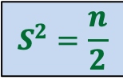




Question
Is it possible to select $S$ such that
…
$$S^{2}=\frac{n}{2}$$
$S$ = $\{2,3,9,−2,−3,−9\}$
$$S^{4}=\frac{n}{4}$$
$$S^{n}=1$$

Slide 7
Complex numbers
Recalling elementary facts

Slide 8
Complex numbers
$$\sqrt{a^{2}+b^{2}}$$
$$a+bi$$
$$=r(\cos{φ}+i\sin{φ})$$
$$x_{1} =r_{1}(\cos{φ_{1}}+i\sin{φ_{1}})$$
$$x_{2} =r_{2}(\cos{φ_{2}}+i\sin{φ_{2}})$$
Addition
$x_{1}+x_{2}$ = ?
Multiplication
$x_{1}⋅x_{2}$ = ?
Complex plane
$$b$$
$$r$$
$$φ$$
$$a$$
Vector addition
$$r_{1}r_{2}(\cos{(φ_{1}+φ_{2})}+i\sin{(φ_{1}+φ_{2})})$$
Magnitudes get multiplied &
Arguments get added… beautiful ☺

Slide 9
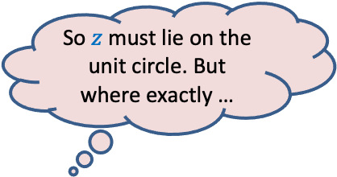

Complex roots of unity
Definition:
A number $z$ is said to be $n$th root of unity
if it satisfies equation.
$$z^{n}=1$$
$$z⋅z⋅z⋅ …⋅z=1$$
Magnitude($z$) = 1
Argument($z$) = ?
$$\{1, ω_{n} ,ω_{n}^{2},ω_{n}^{3},…,ω_{n}^{n−1}\}$$
Complex plane
$$\frac{2π}{n}$$
$$1$$
multiple of $\frac{2π}{n}$
$$R_{n}=$$
Unit circle
So $z$ must lie on the unit circle. But where exactly …
$n^{th}$Principal rool of unity

Slide 10

Complex roots of unity
$$R_{3}$$
What is $\left\{x^{2} \right|x∈R_{3}\}$ ?
$$R_{4}$$
What is $\left\{x^{2} \right|x∈R_{4}\}$ ?
$$ω_{4}^{1}$$
$$ω_{3}^{1}$$
$$ω_{3}^{3}$$
$$ω_{4}^{2}$$
$$ω_{4}^{4}$$
$$ω_{3}^{2}$$
$$ω_{4}^{3}$$
$$R_{3}$$
$$R_{2}$$

Slide 11
Complex roots of unity
Theorem:
If $n$ is odd $\left\{x^{2} \right|x∈R_{n}\}=R_{n}$
If $n$ is even $\left\{x^{2} \right|x∈R_{n}\}=$ $R_{\frac{n}{2}}$
Is it possible to select $S$ such that
…
?
$$S^{2}=\frac{n}{2}$$
$$S^{4}=\frac{n}{4}$$
$$S^{n}=1$$
$$S=R_{n}$$

Slide 12
Solving the sub-problem
points
for
evaluation
$A\left(x\right)=$ $A_{even}$($x^{2}$) + $x A_{odd}$($x^{2}$)
degree
$$A$$
$$<n$$
$$R_{n}$$
T($n$) = Time complexity of Evaluating $A\left(x\right)$ on $R_{n}$
= a$n$ + $2$T($\frac{n}{2}$)
$$A_{even}$$
$$A_{odd}$$
$$<n/2$$
$$R_{\frac{n}{2}}$$
$$<n/4$$
$$R_{\frac{n}{4}}$$
$$<1$$
$$R_{1}$$

Slide 13
O($n^{2}$) time
☹
$$A\left(x\right)$$
$$B\left(x\right)$$
Coefficient
represntation
<$a_{0}, a_{1},a_{2},…,a_{n−1}$>
<$b_{0}, b_{1},b_{2},…,b_{n−1}$>
<$c_{0}, c_{1},c_{2},…,c_{2n−2}$>
O($n$ log $n$) time
Done
?
O($n$ log $n$) time
{$\left(r_{0}, A\left(r_{0}\right)\right),…,(r_{2n−2}, A\left(r_{2n−2}\right)$}
{$\left(r_{0}, B\left(r_{0}\right)\right),…,(r_{2n−2}, B\left(r_{2n−2}\right)$}
{$\left(r_{0}, C\left(r_{0}\right)\right),…,(r_{2n−2}, C\left(r_{2n−2}\right)$}
O($n$) time
☺

Slide 14
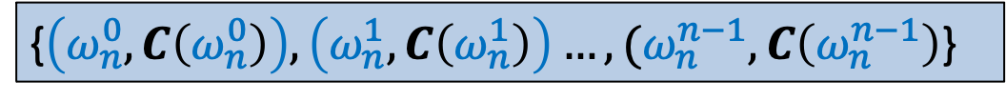
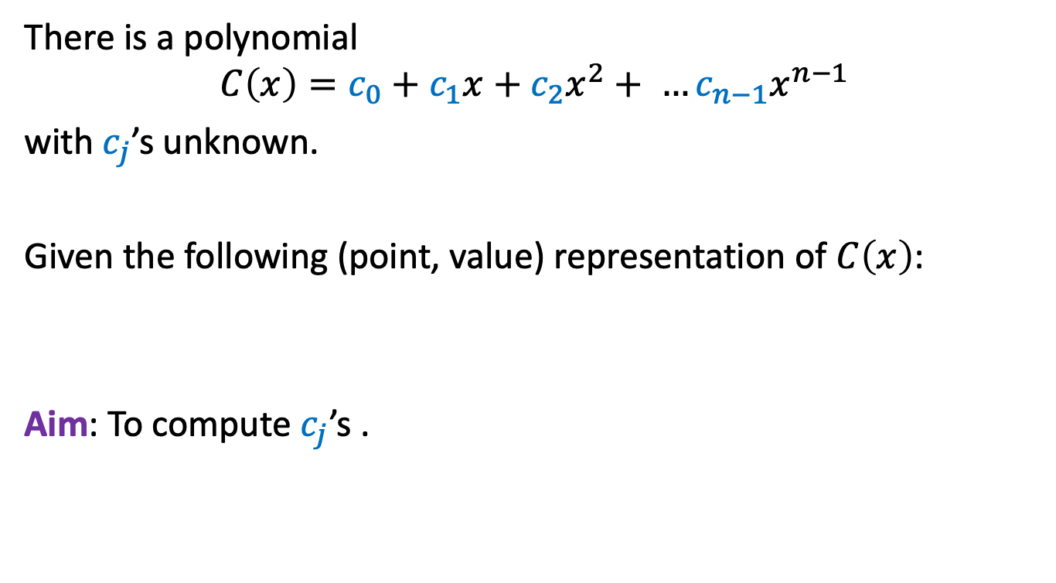
Interpolation
There is a polynomial
$$C\left(x\right)=c_{0}+c_{1}x+c_{2}x^{2}+ …c_{n−1}x^{n−1}$$
with $c_{j}$’s unknown.
Given the following (point, value) representation of $C\left(x\right)$:
Aim: To compute $c_{j}$’s .
{$\left(ω_{n}^{0}, C\left(ω_{n}^{0}\right)\right),\left(ω_{n}^{1}, C\left(ω_{n}^{1}\right)\right)…,(ω_{n}^{n−1}, C\left(ω_{n}^{n−1}\right)$}

Slide 15
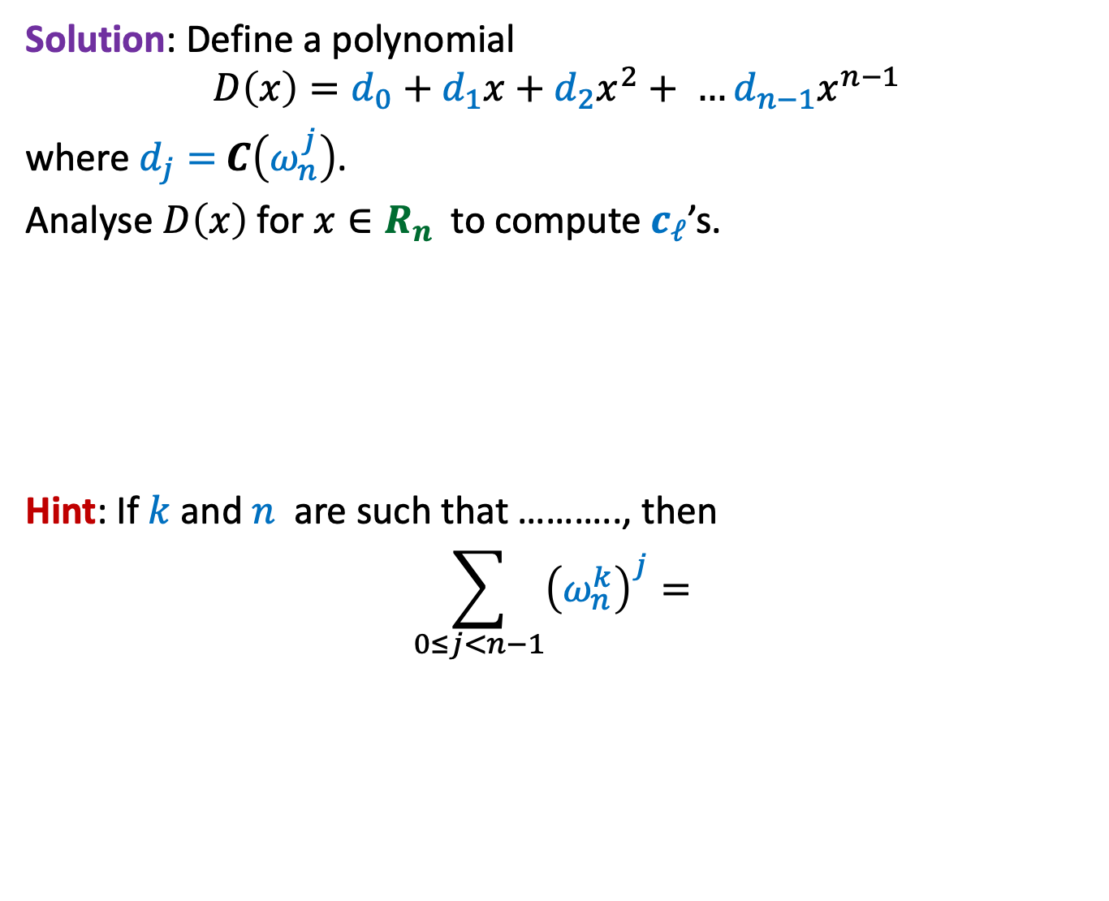
Interpolation
Solution: Define a polynomial
$$D\left(x\right)=d_{0}+d_{1}x+d_{2}x^{2}+ …d_{n−1}x^{n−1}$$
where $d_{j}=$ $C\left(ω_{n}^{j}\right)$.
Analyse $D\left(x\right)$for $x∈R_{n}$ to compute $c_{ℓ}$’s.
Hint: If $k$ and $n$ are such that ……….., then
$$\sum_{0≤j<n−1}{{\left(ω_{n}^{k}\right)}^{j}= }$$
H
O
M
E
W
O
R
k
{$\left(ω_{n}^{0}, C\left(ω_{n}^{0}\right)\right),\left(ω_{n}^{1}, C\left(ω_{n}^{1}\right)\right)…,(ω_{n}^{n−1}, C\left(ω_{n}^{n−1}\right)$}
0

Slide 16
Optional Homework
For those of you, who love competitive programming,
try to write a neat code for the algorithm we discussed for multiplication of two polynomials.
How will you implement complex numbers ?

